Slide 1


DEPARTMENT OF ELECTRONICS & TELECOMMUNICATION ENGINEERING
INAUGRATION OF ELECTEL
Forum Under Institution of Electronics and Telecommunication Engineers

Slide 2

LIGHTING
OF
LAMP

Slide 3

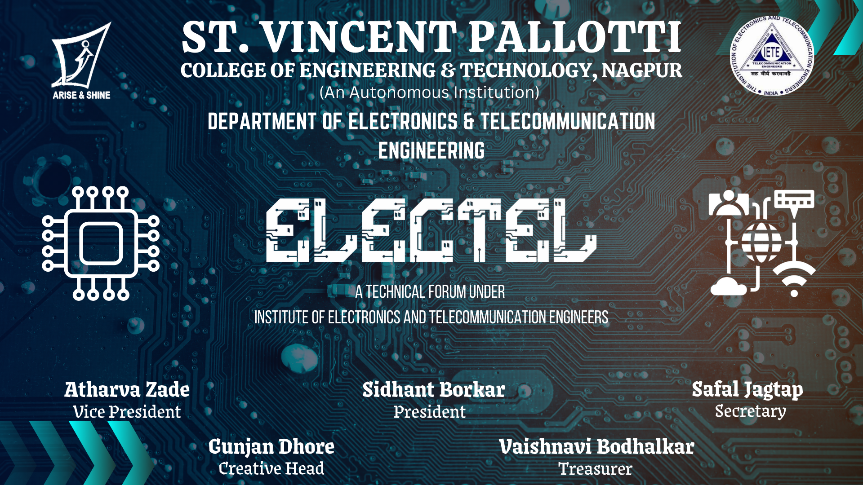






Slide 4

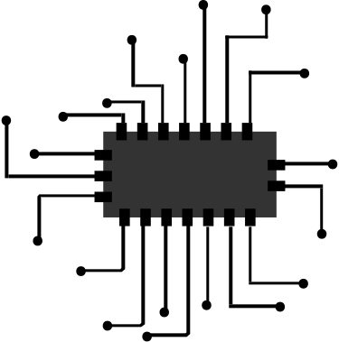




What is IETE ?
IETE (Institution of Electronics and Telecommunication Engineers) is a professional society in India.
Supports students, engineers, and academicians in technical growth.
IETE fosters innovation, research,
and professional growth and is a
great platform for students to enhance
technical & leadership skills
Focuses on advancing Electronics, Telecommunications, and IT.
The forum connects students
with industry experts through events,
providing career insights, mentorship,
and internship opportunities.
Provides education, research support, and industry collaboration.

Slide 5

Introducing ELECTEL
Industry Interaction – Bridge the gap between students and industry experts through guest lectures and industrial visits.
Electel is the official forum of the Electronics
and Telecommunication department.
Encourage Innovation – Promote research, projects, and creative problem-solving.
ELECTEL
Collaboration & Networking – Create a platform for students to share ideas and work on projects together.
TELECOM-
ELECTRONICS
MUNICATION

Slide 6

WHY IS THIS FORUM BEING CREATED?
To enhance collaboration, share knowledge, and provide resources for students.
WORKSHOP & EVENTS
PROJECT & RESEARCH
Enhance your skills through interactive workshops and dynamic events led by industry experts.
Transform innovative ideas into reality with cutting-edge research and hands-on project development.
INDUSTRY TRENDS
& INNOVATIONS
GENERAL
Discussion
Stay ahead with the latest industry trends and breakthrough innovations shaping the future of technology.
Engage in thought-provoking discussions to explore ideas, solve challenges, and expand your technical horizon.

Slide 7

Domains Under Electel
Circuitry
Software Sector
Core
SOFT
Circuit simulation.
PCB design.
signal processing.
power electronics.
IoT Hardware Development.
Soft
Python, C, C++,Java.
MATLAB, VHDL.
AI & ML in electronics.
Domain
Embedded Systems
Higher Studies & Entrepreneurship
CORE
OTHER
Core
Other
Embedded programming.
Internet of Things (IoT) applications.
Engineering & Technology
Business & Management
Tech Startups
Manufacturing & Hardware

Slide 8

THE CREATOR’S IGNITE
About Event
The Startup Innovation Challenge brings students together to develop and pitch innovative business ideas. Teams brainstorm, plan, and present their concepts to judges, with top ideas earning prizes and mentorship. It’s a platform for creativity, teamwork, and entrepreneurial growth. Pitching their idea to a panel of judges who will provide constructive feedback
Objectives:
Encourage Innovation – Inspire students to think creatively and develop
unique business ideas.
Enhance Collaboration – Promote teamwork by mixing students from
different years with diverse skill sets.
Develop Entrepreneurial Skills – Help students learn about
business planning, strategy, and execution.
Improve Presentation & Communication – Provide an opportunity
to pitch ideas effectively to judges.
Exploring creativity

Slide 9

VOTE OF THANKS

Slide 10
Thank you very much!

